Slide 1

AppleCheck: Logistic Regression for Quality Assessment
Elissa Mohd Azhari

Slide 2

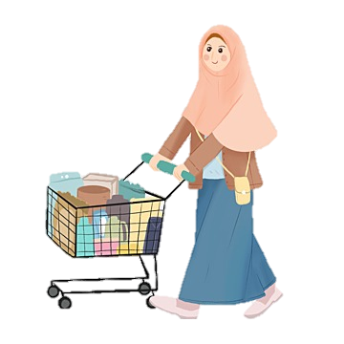
How do I tell if the apple is good?
Is it crunchy?
Is it juicy?

Slide 3

Problem
Inconsistency fruit quality sold in market which contributes to food insecurity.
FOOD SECURITY!
Source: THE 17 GOALS | Sustainable Development. (n.d.). https://sdgs.un.org/goals

Slide 4
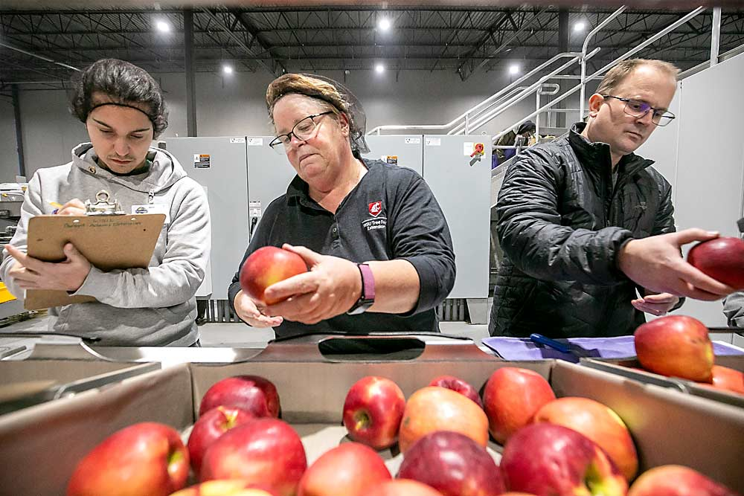
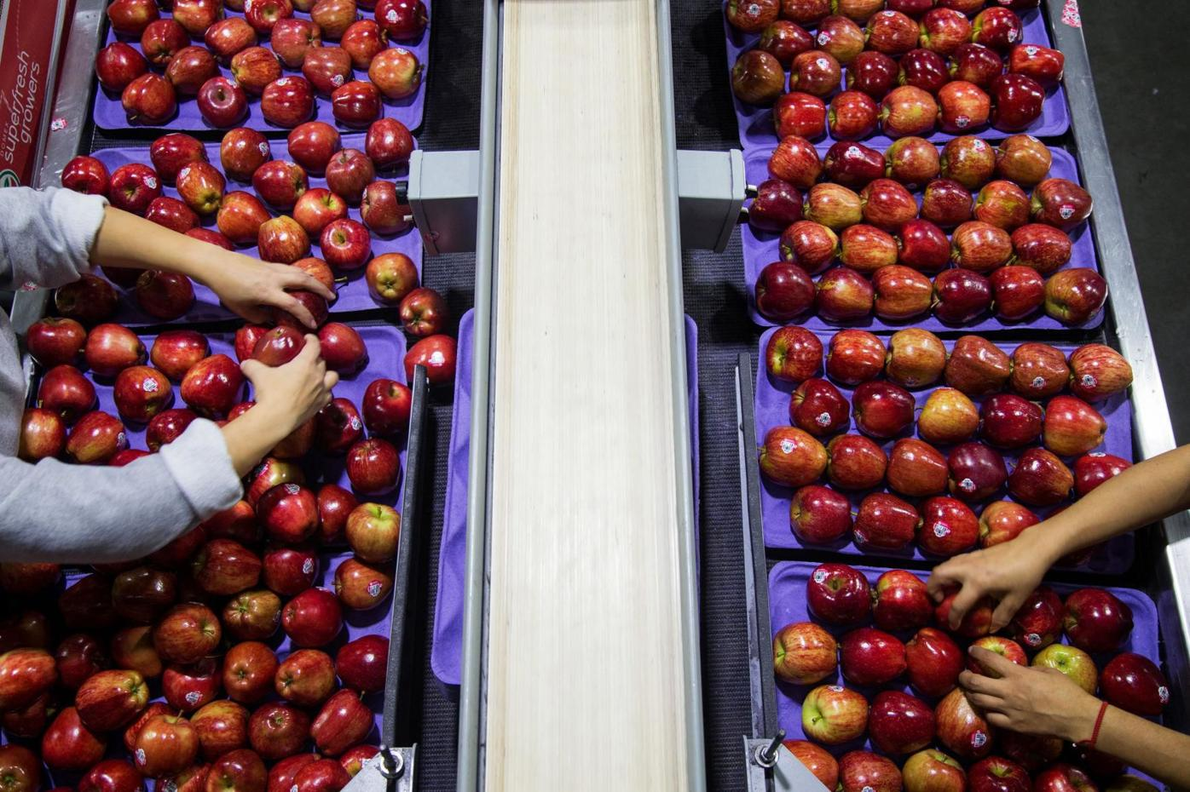
Currently, in the industry..
Visual inspection
Grading by size
Color sorting
Weight sorting
Internal quality inspection
Storage & Transportation monitoring
Source: Courtney, R., & Courtney, R. (2021, September 28). Hot start continues for Cosmic Crisp - Good Fruit Grower. Good Fruit Grower -. https://www.goodfruit.com/hot-start-continues-for-cosmic-crisp/

Slide 5

What is my target?
To manage mass & assorted data
To store data in a cloud database
To build a predictive model
To increase the quality of apples sold in supermarkets & ensuring food security!

Slide 6
My solution:
Visual inspection
Grading by size
Color sorting
Weight sorting
Internal quality inspection
Storage & Transportation monitoring
Bruises
Cuts
Discoloration
Blemishes
Done using grading machines
Done using optical sensors
Done using weight sorting machines
Xray imaging & NIR (Near infrared)
Optimal temperatures are ensured
DATA
DATA
DATA
DATA
DATA
DATA
DATA
Data analysis & Automation

Slide 7
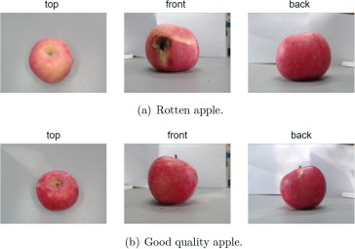


Stores your data in a
cloud database
Predicts the quality of Apples
Secured
Flexible
Accessibility
Data you want
database
What can AppleCheck do?
Users can monitor
real-time performance
Reports will be sent to users bi-weekly

Slide 8
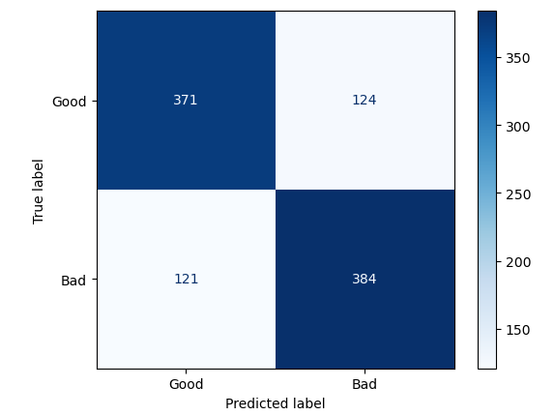
How reliable is AppleCheck?
Table 1. The first four lines of pre-existing data available on Kaggle
A_id | Size | Weight | Sweetness | Crunchiness | Juiciness | Ripeness | Acidity | Quality
0 | -3.97005 | -2.51234 | 5.34633 | -1.01201 | 1.8449 | 0.32984 | -0.49159 | good
1 | -1.19522 | -2.83926 | 3.664059 | 1.588232 | 0.853286 | 0.86753 | -0.72281 | good
2 | -0.29202 | -1.35128 | -1.73843 | -0.34262 | 2.838636 | -0.03803 | 2.621636 | bad
3 | -0.6572 | -2.27163 | 1.324874 | -0.09787 | 3.63797 | -3.41376 | 0.790723 | good
Accuracy of 75.5%!!!!

Slide 9
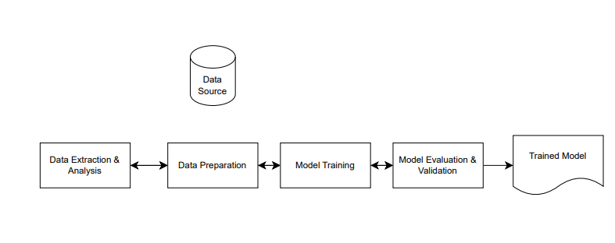
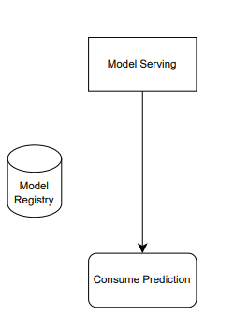
How AppleCheck works?
The Mlops Lifecycle
Machine Learning
Operations
Manual steps
Experiments/Development/Testing
Production
Source:Bodor, A., Hnida, M., & Daoudi, N. (2023, December 12). Machine Learning Models Monitoring in MLOps Context: Metrics and Tools. International Journal of Interactive Mobile Technologies (IJIM), 17(23), 125–139. https://doi.org/10.3991/ijim.v17i23.43479

Slide 10
References
Shi, X., Chai, X., Yang, C., Xia, X., & Sun, T. (2022, April). Vision-based apple quality grading with multi-view spatial network. Computers and Electronics in Agriculture, 195, 106793. https://doi.org/10.1016/j.compag.2022.106793
THE 17 GOALS | Sustainable Development. (n.d.). https://sdgs.un.org/goals
Courtney, R., & Courtney, R. (2021, September 28). Hot start continues for Cosmic Crisp - Good Fruit Grower. Good Fruit Grower -. https://www.goodfruit.com/hot-start-continues-for-cosmic-crisp/
Apple Quality. (2024, January 11). Kaggle. https://www.kaggle.com/datasets/nelgiriyewithana/apple-quality
Bodor, A., Hnida, M., & Daoudi, N. (2023, December 12). Machine Learning Models Monitoring in MLOps Context: Metrics and Tools. International Journal of Interactive Mobile Technologies (IJIM), 17(23), 125–139. https://doi.org/10.3991/ijim.v17i23.43479

Slide 11
Thank you

Slide 12
Appendix

